Slide 1


Programming Two (csc7051)
Aidan McGowan
Introduction to GUI Development using Java FX including Java Events

Slide 2
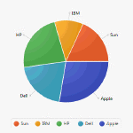
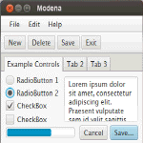
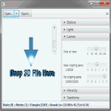
Building manually
JavaFX is a set of graphics and media packages that enables developers to design, create, test, debug, and deploy rich client applications GUIs.
Notes:
http://commondatastorage.googleapis.com/eclipse_toolreleases/products/d2wbpro/release/v1.6.0_201305212103/4.2

Slide 3
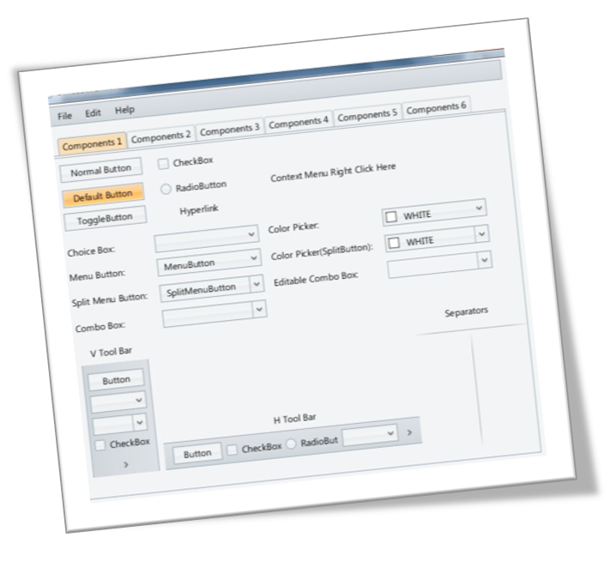
JavaFX UI Controls and Layouts
Labels, Buttons, Radio Buttons, Checkbox, Text Field, Combo Box, Menu
Layouts

Slide 4
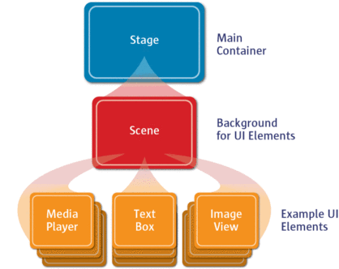
Setting the Stage and Scene !
The Stage is the main container which is usually a Window with a border and the typical minimize, maximize and close buttons.
Inside the Stage you add a Scene which can, of course, be switched out by another Scene.
Inside the Scene there is a Layout and in this are actual JavaFX nodes like , TextBox, Buttons etc. are added.

Slide 5
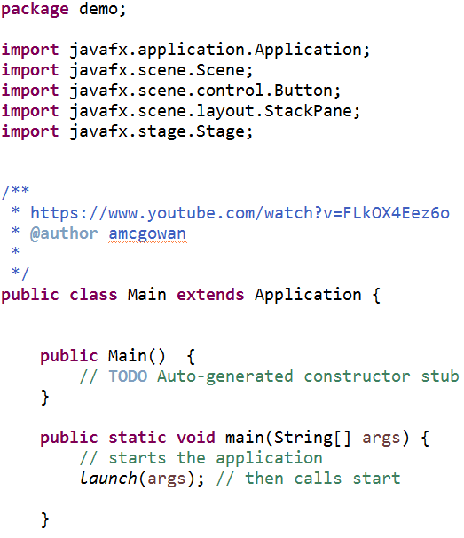
Hello World
Import these
Extend the Application class
Add a method call to launch()

Slide 6
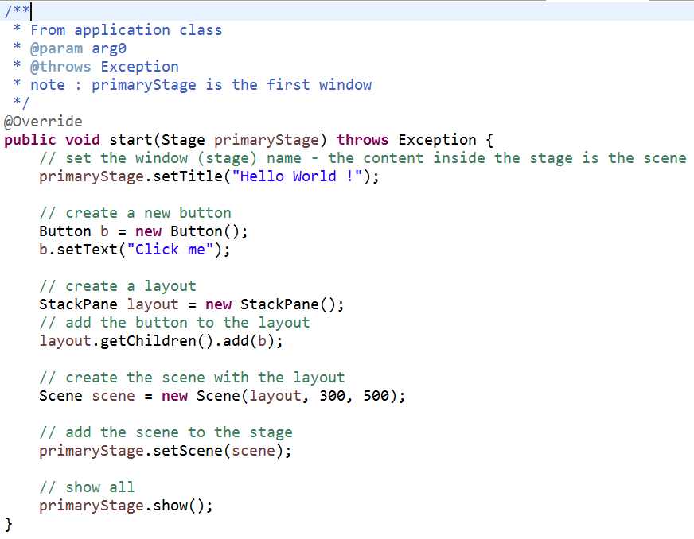
Hello World
Implement the start method (called by launch)
Creating a button
Creating a layout and adding the button to it
Creating a scene and adding
the layout to it
Set the scene in the window (Stage) and showing

Slide 7
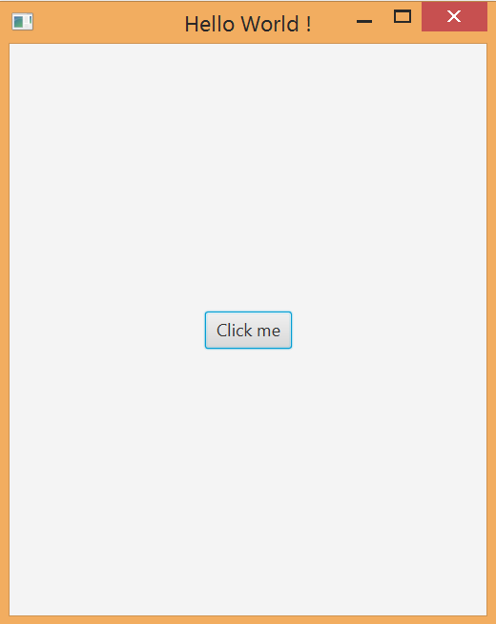
Hello World
Ok … but doesn’t really do anything. We need an event !

Slide 8
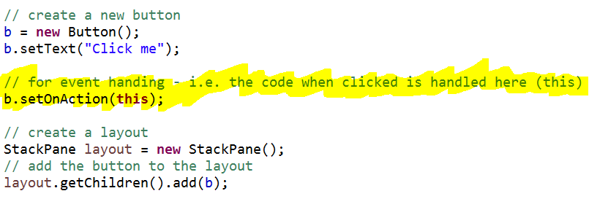
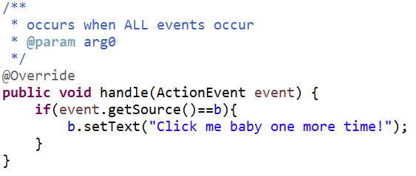
Adding a common event handler
Adding this code makes the button and event source. (Note the button needs to be now declared outside the start method)
This code is the listener for the button or all register events

Slide 9
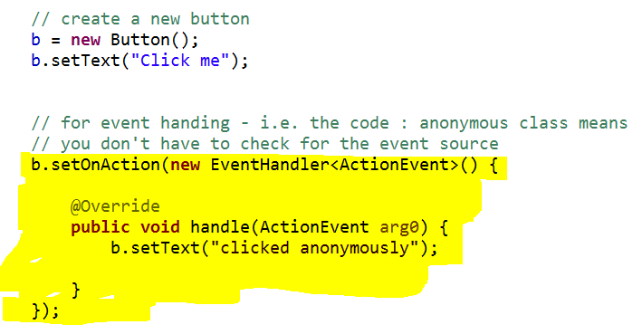
Event handling (alternative) – anonymous inner class

Slide 10
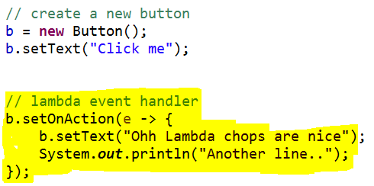
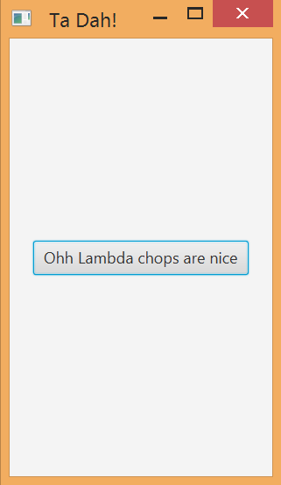
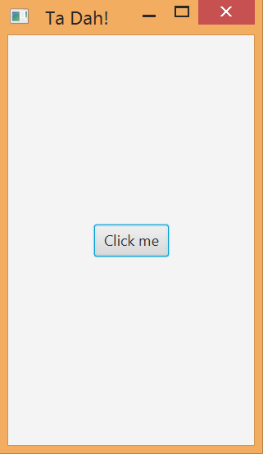
Event handling (alternative) – lambda expressions
New in Java 8

Slide 11
lambda expressions
A lambda expression is an anonymous function (not 100% true for Java but lets assume it for time being). Simply put, it’s a method without a declaration, i.e., access modifier, return value declaration, and name.
It’s a shorthand that allows you to write a method in the same place you are going to use it. Especially useful in places where a method is being used only once, and the method definition is short. It saves you the effort of declaring and writing a separate method to the containing class.

Slide 12
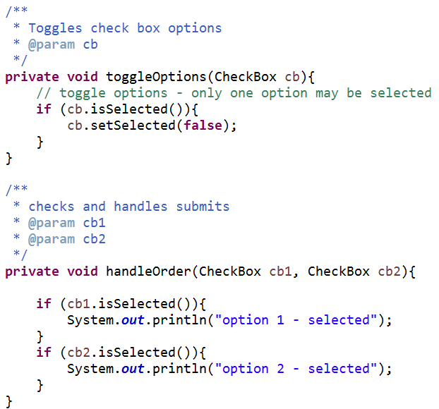
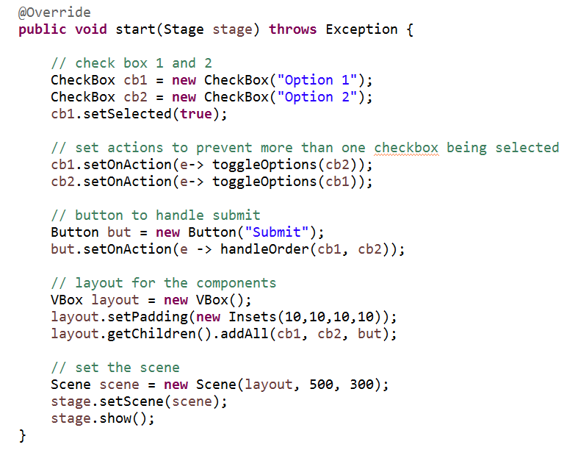
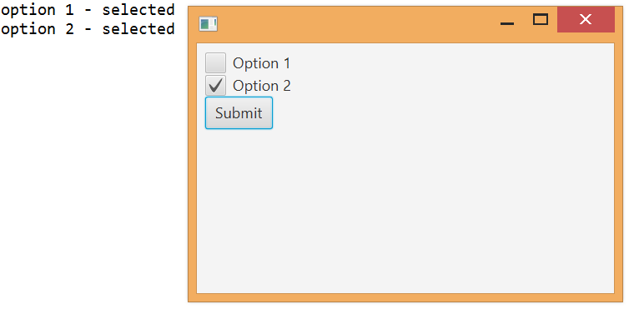
Checkboxes

Slide 13
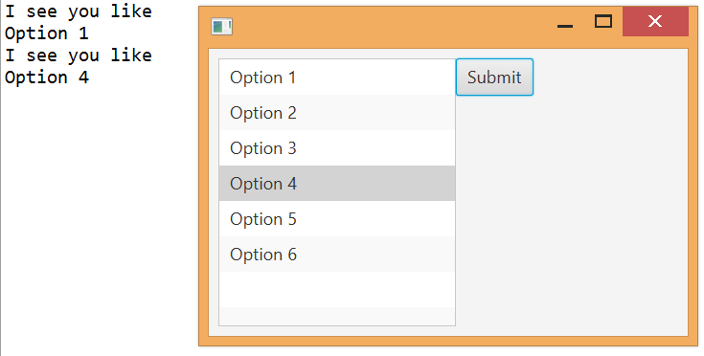
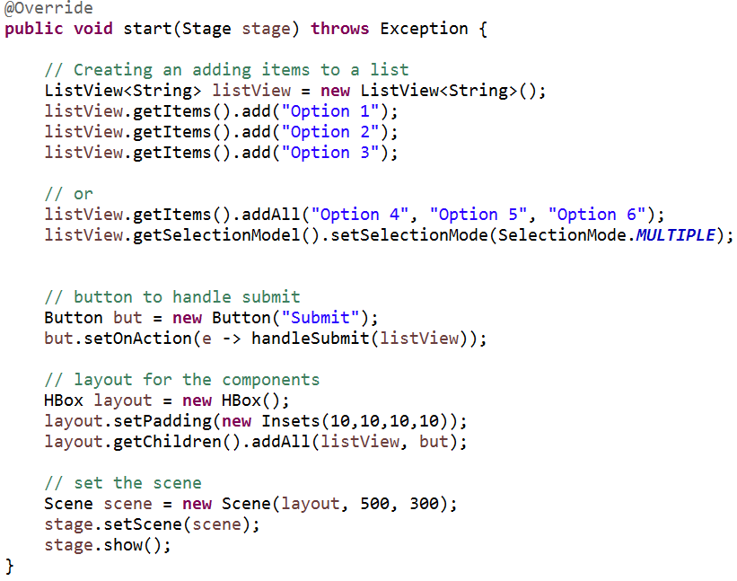
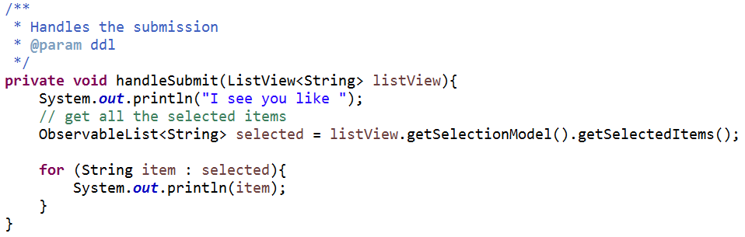
ListView

Slide 14
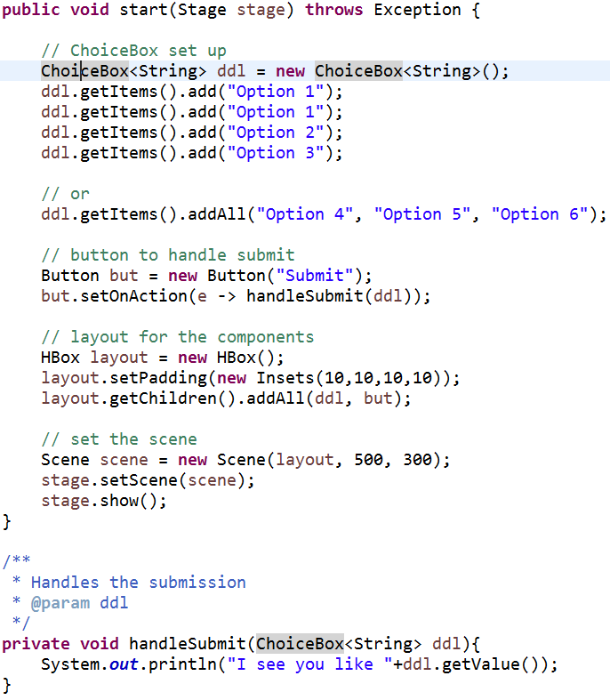
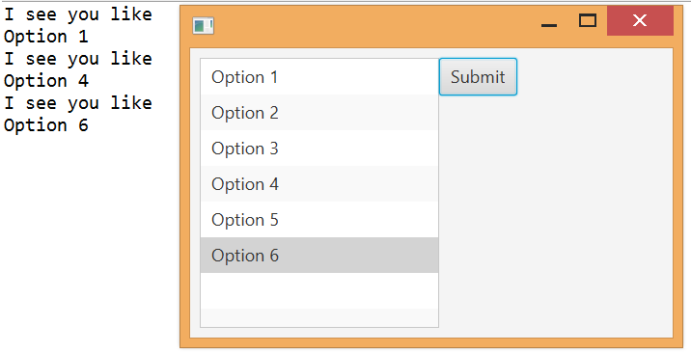
ChoiceBox
Notes:
http://docs.oracle.com/javafx/2/ui_controls/choice-box.htm

Slide 15
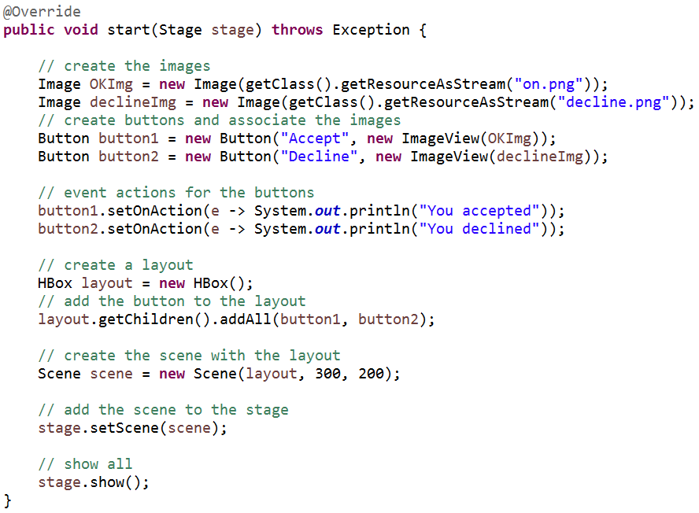
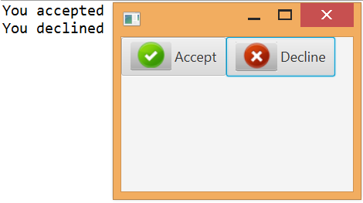
Buttons with images
The image files in this case are located in the src folder

Slide 16
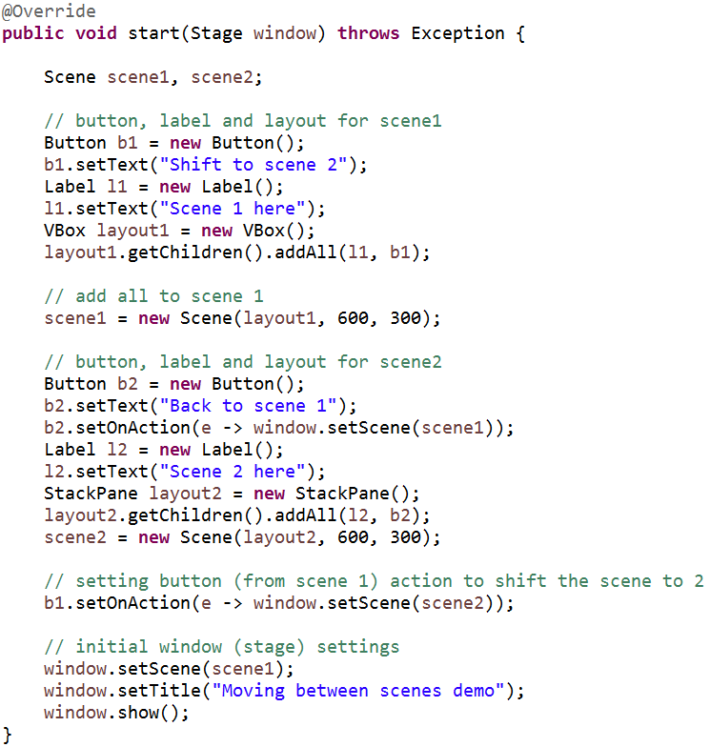
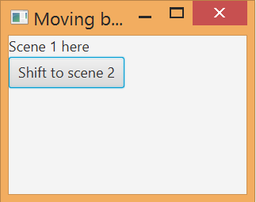
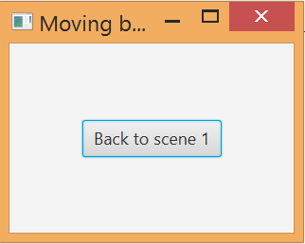
Dynamically moving between scenes

Slide 17
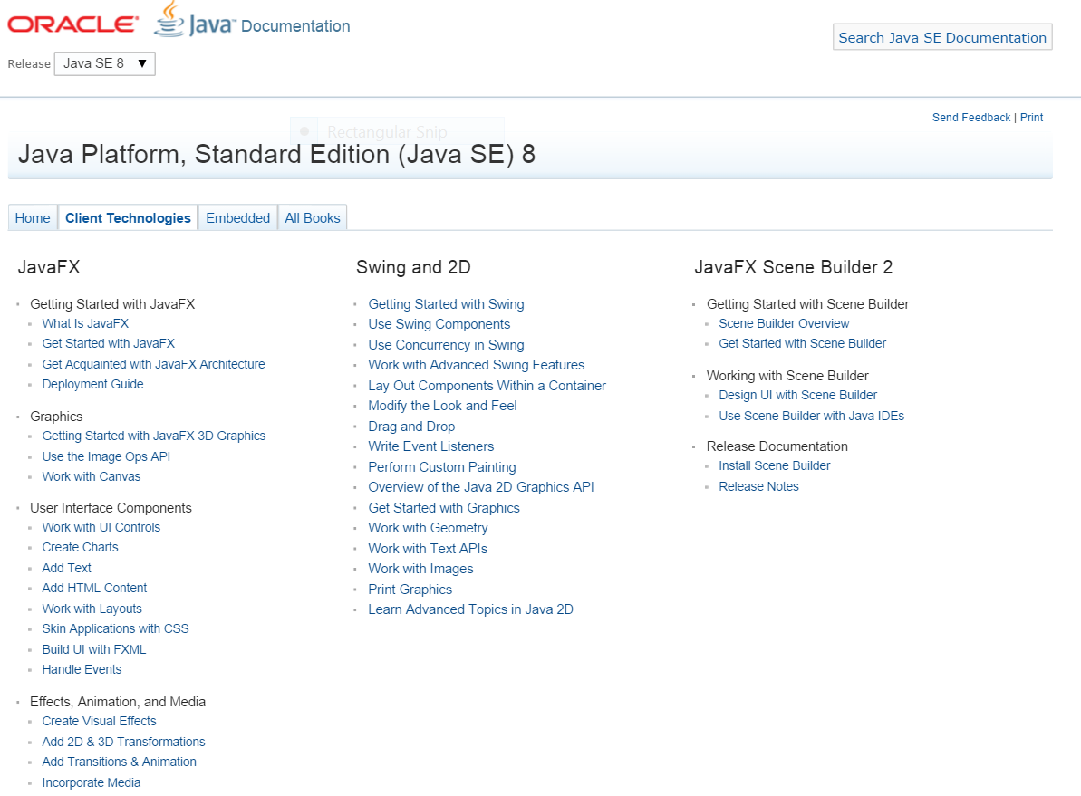
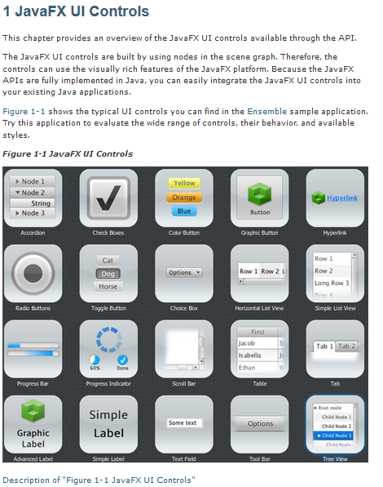
Further reading
http://docs.oracle.com/javase/8/javase-clienttechnologies.htm
http://docs.oracle.com/javafx/2/ui_controls/overview.htm
Notes:
http://docs.oracle.com/javase/8/javase-clienttechnologies.htm
http://docs.oracle.com/javafx/2/ui_controls/overview.htm

